Slide 1
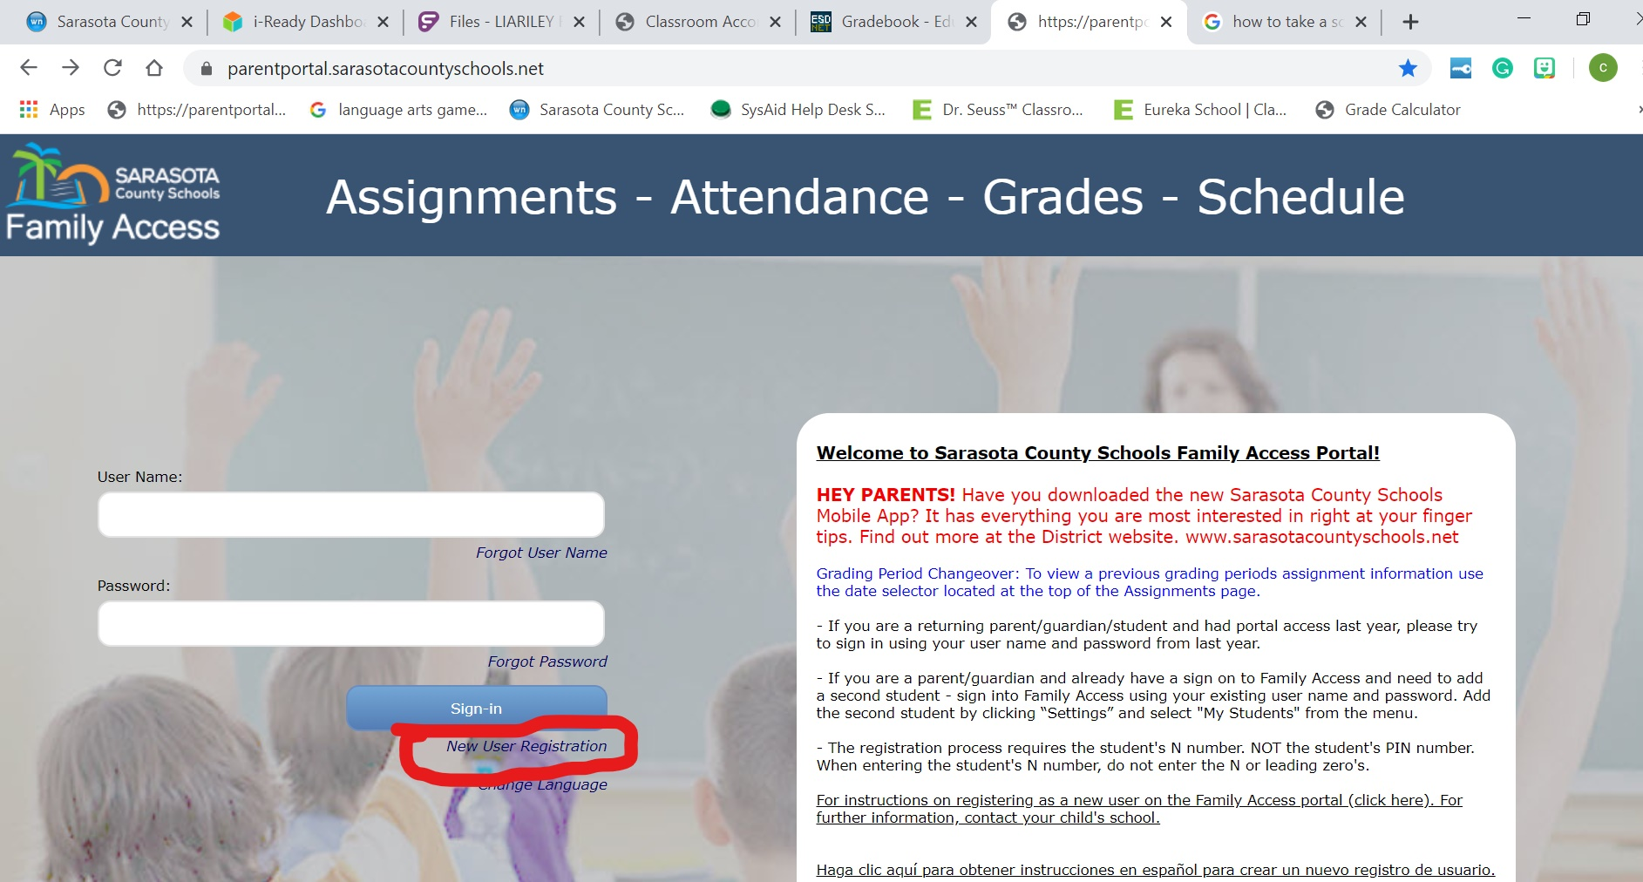

Slide 2
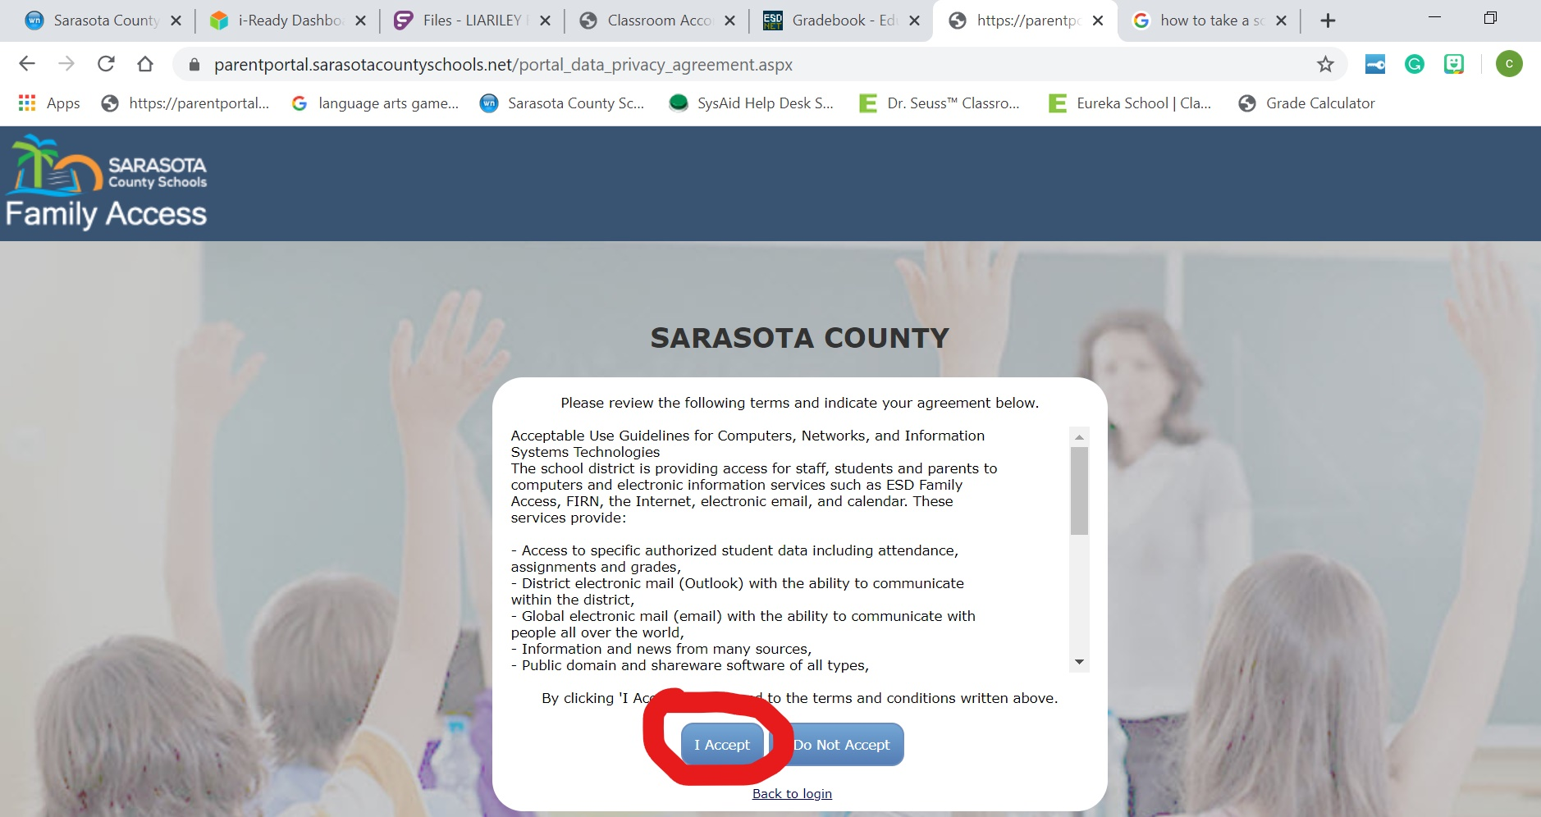

Slide 3
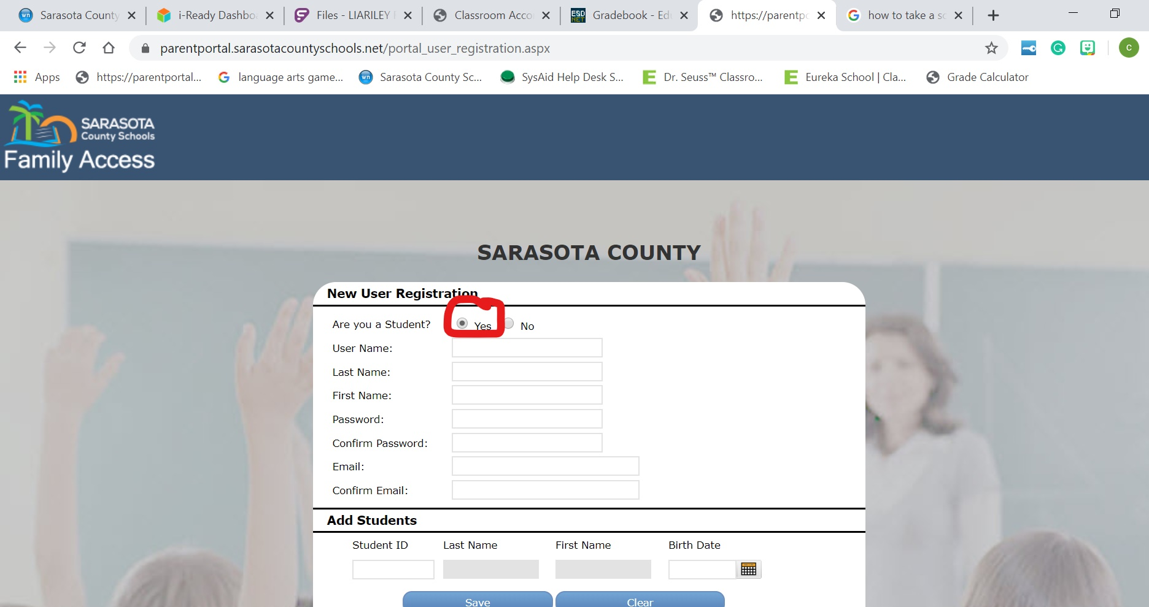

Slide 4
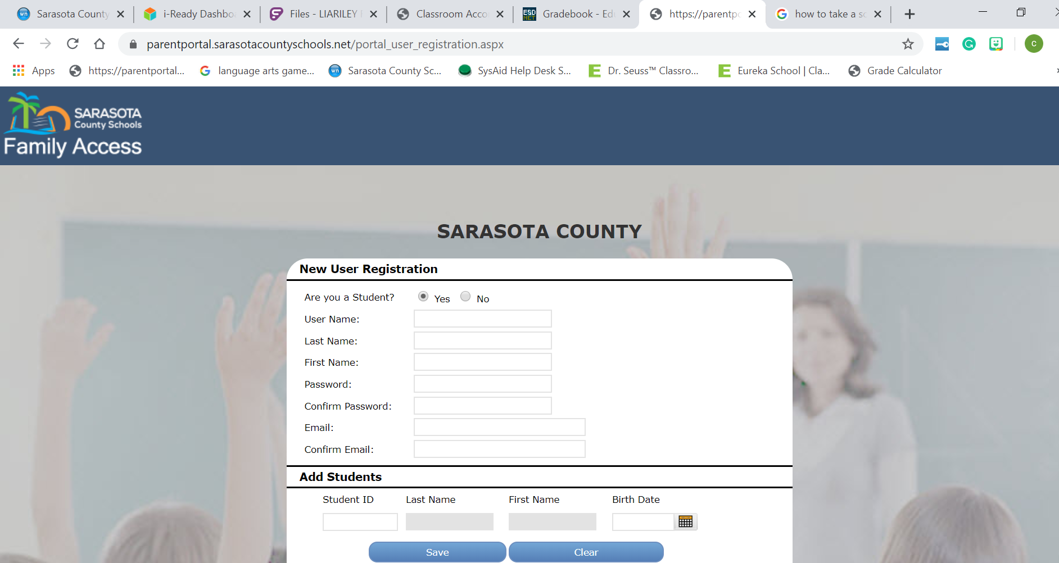
n342948
Use your N number
Fill in all the boxes with YOUR information
Last name
First name
Pin number
Pin number
n342948@student.sarasotacountyschools.net
n342948@student.sarasotacountyschools.net
Your N number without the N
MM/DD/YYYY format

Slide 5
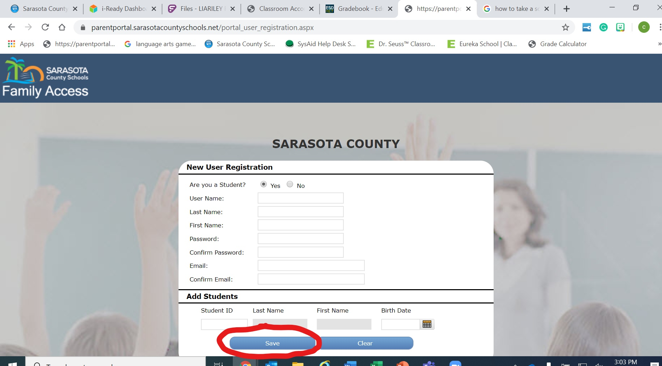

Slide 6
You will now need to log in with your username and password
Go to your email and get your access code that got email to you
Type in the code and you should be able to see your grades

